Slide 1
Analysis of Functional Connectivity and Oscillatory Power Using DICS: From
Raw MEG Data to Group-Level
Statistics in Python
Don Enrico Esteve (P9550217B), Elizabeth Vaisman (318775277)

Slide 2
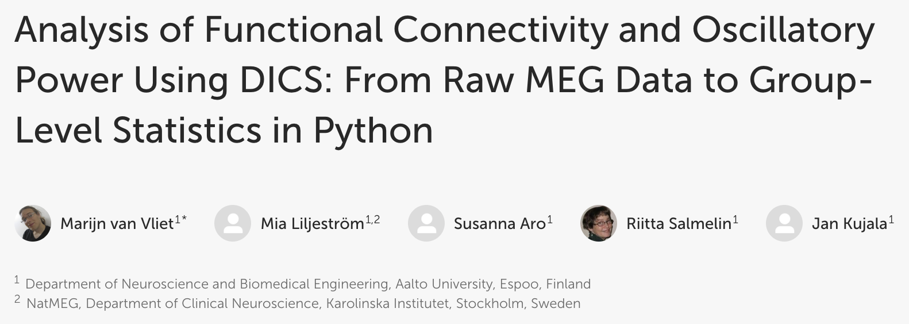
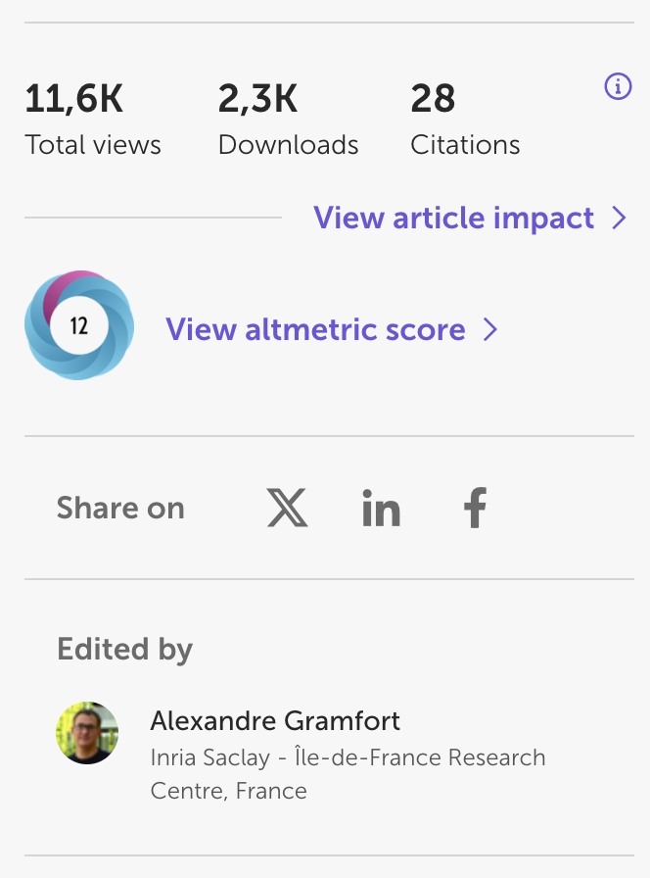
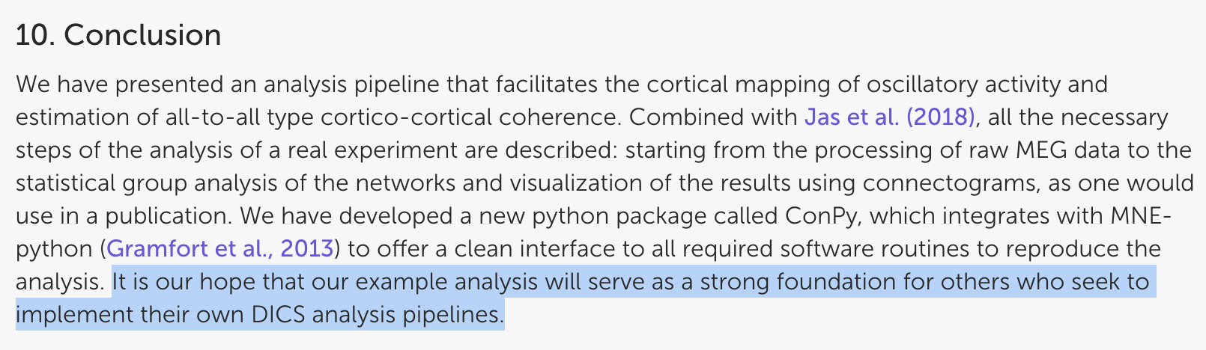
Introduction
Methods
Results
Conclusion
What is the selected article about?

Slide 3
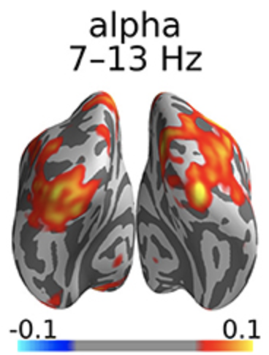
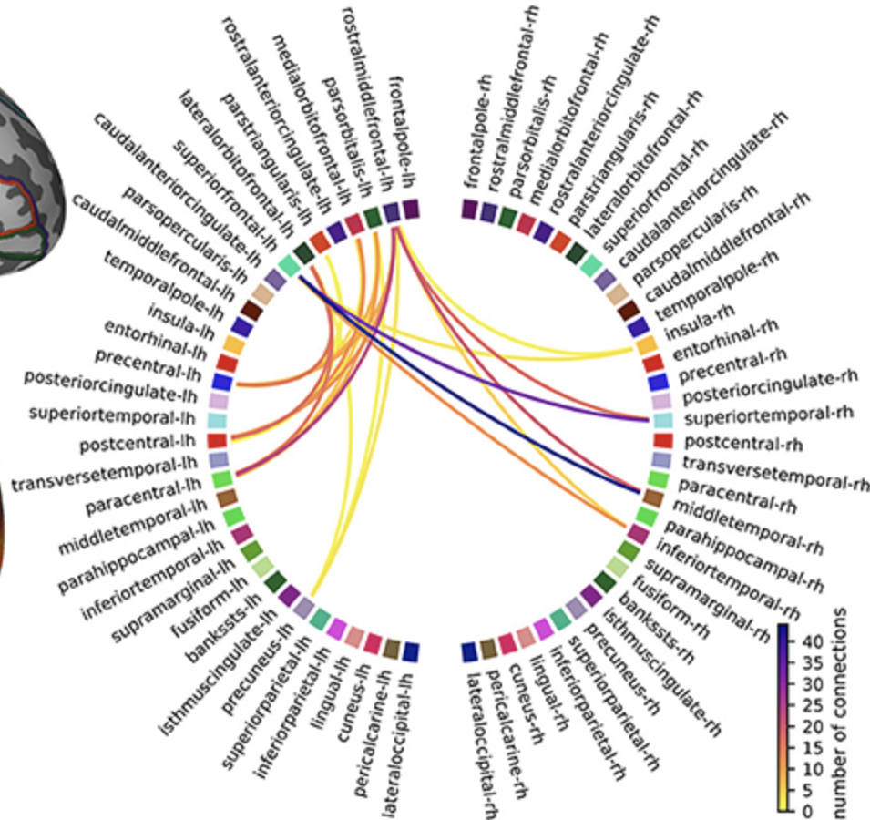
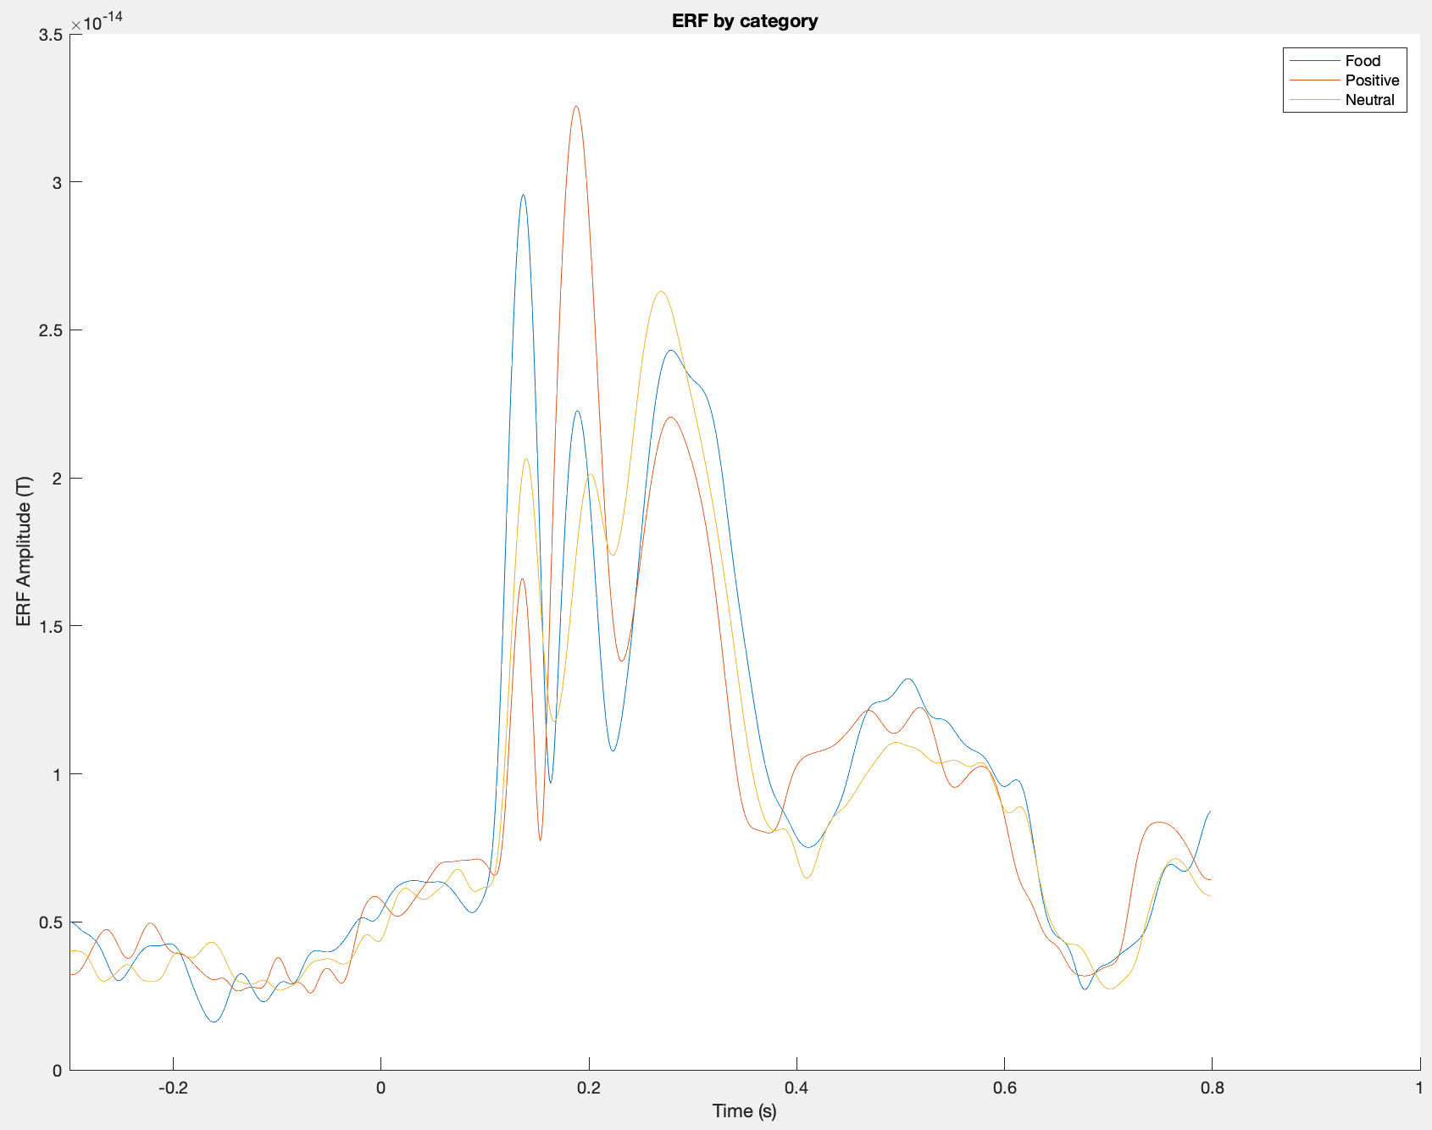



Introduction
Methods
Results
Conclusion
What are we trying to achieve?
Pipeline Replication
Pipeline Implementation
Oscillatory power & functional connectivity (Van Vliet et al., 2018)
MEG dataset from repeated visual food cues (MEG-BIU lab)

Slide 4
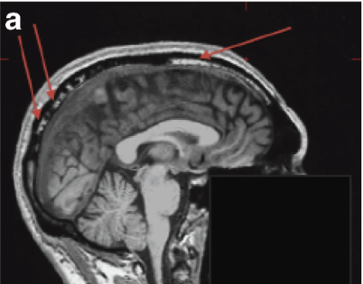
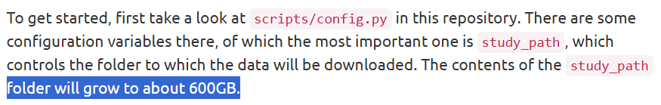

How did the pipeline replication and implementation go?
1
Acquire dataset and perform anatomical MRI processing
Introduction
Methods
Results
Conclusion
https://users.aalto.fi/~vanvlm1/conpy/
Notes:
In bold are the hyperparameters

Slide 5
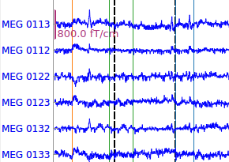
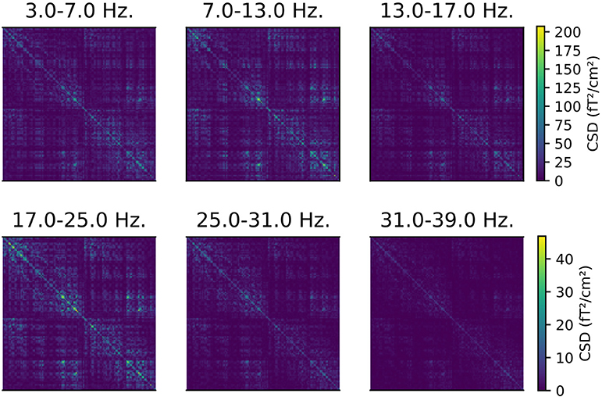
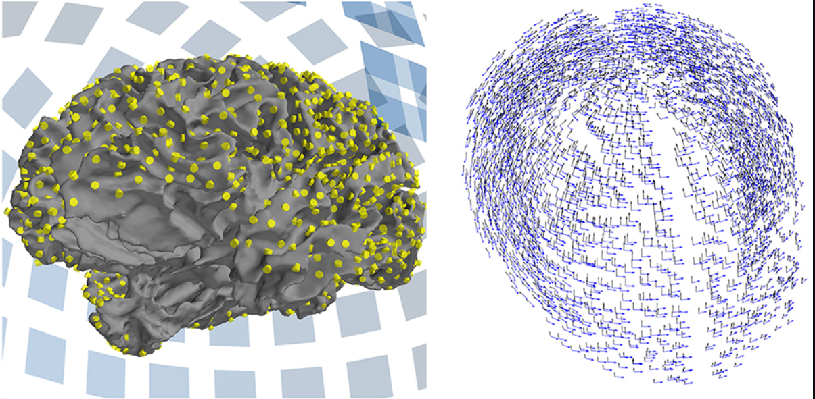
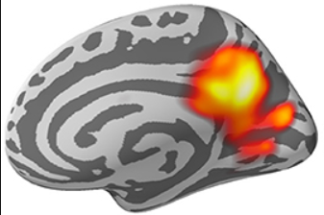
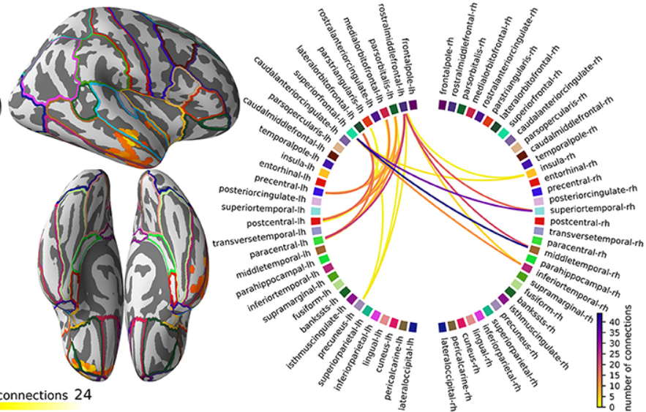
How did the pipeline replication and implementation go?
1
2
3
Acquire dataset and perform anatomical MRI processing
Filter, epoch, and perform ICA on raw MEG recordings
Compute cross-spectral density (CSD) matrices
4
5
6
Define source spaces and forward models
Calculate oscillatory power and its grand average
Perform connectivity analysis and permutation tests
Introduction
Methods
Results
Conclusion
Notes:
In bold are the hyperparameters

Slide 6
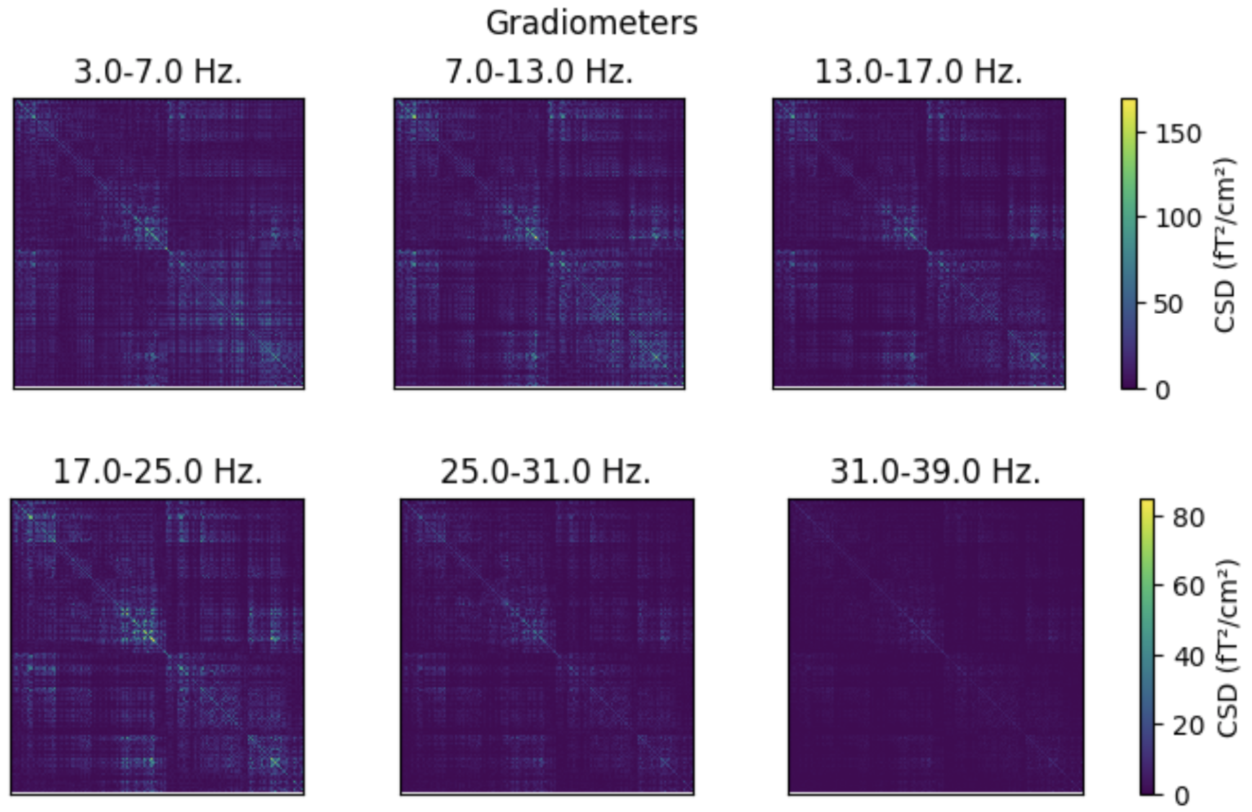
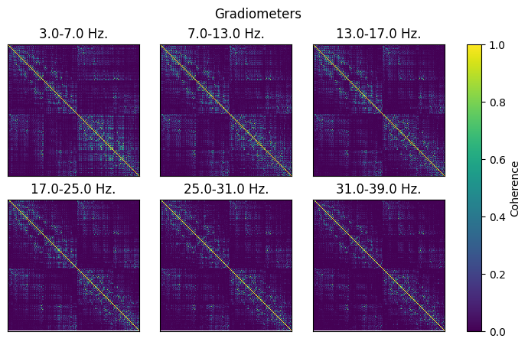
What are the outcomes of the pipeline replication?
Figure 1. CSD (left) and coherence (right) matrices for each frequency band (n=6) where a normal face was presented to Subject 1
Introduction
Methods
Results
Conclusion
Same patterns/trends; different values
Additional result; improvement #1
Notes:
In bold are the hyperparameters

Slide 7
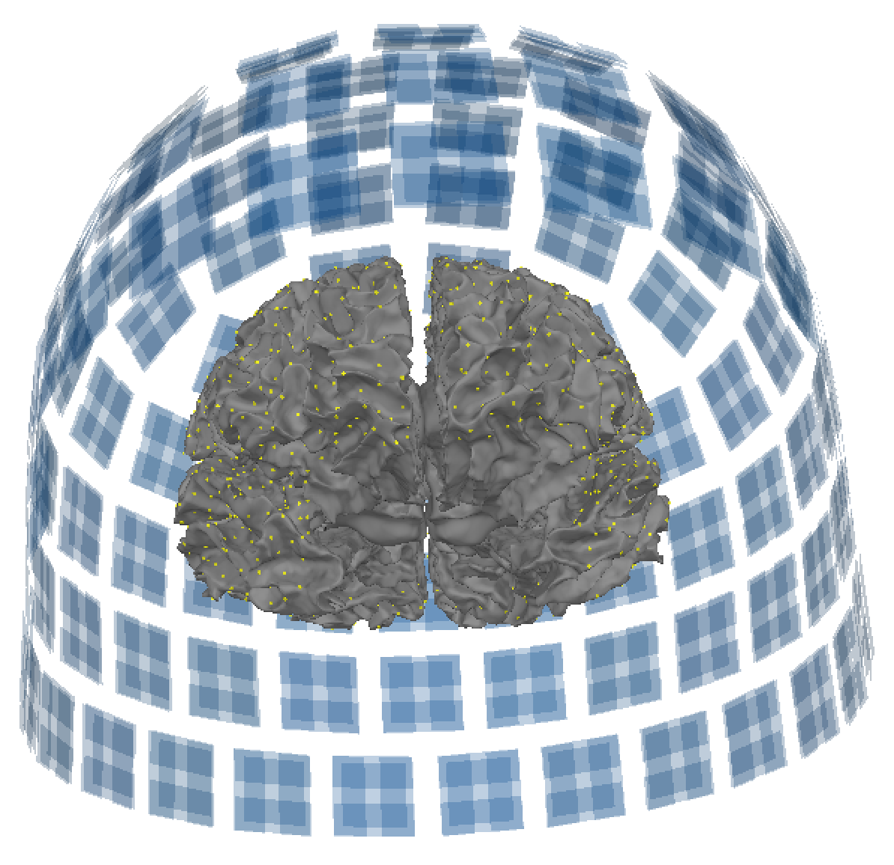
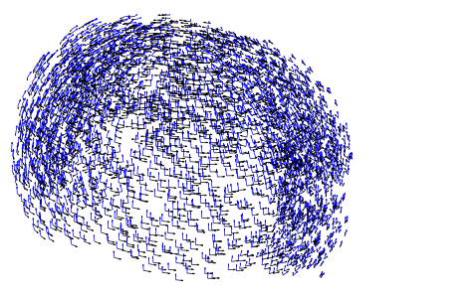
What are the outcomes of the pipeline replication?
Gradiometers
Direction 1
1-layer BEM
Direction 2
Source space
Figure 2. 3D alignment of sensors, BEM, and source space (left); forward solution (right) defining two tangential dipoles for Subject 1
Introduction
Methods
Results
Conclusion
Both are exactly the same from the article!
Notes:
In bold are the hyperparameters

Slide 8
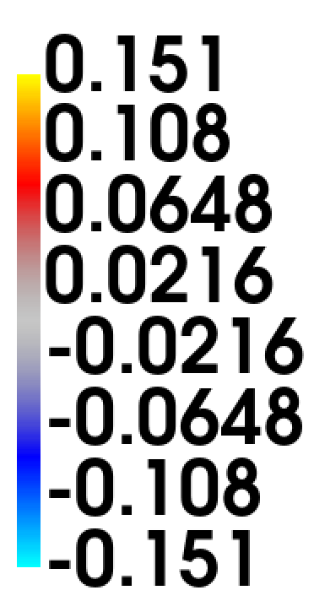
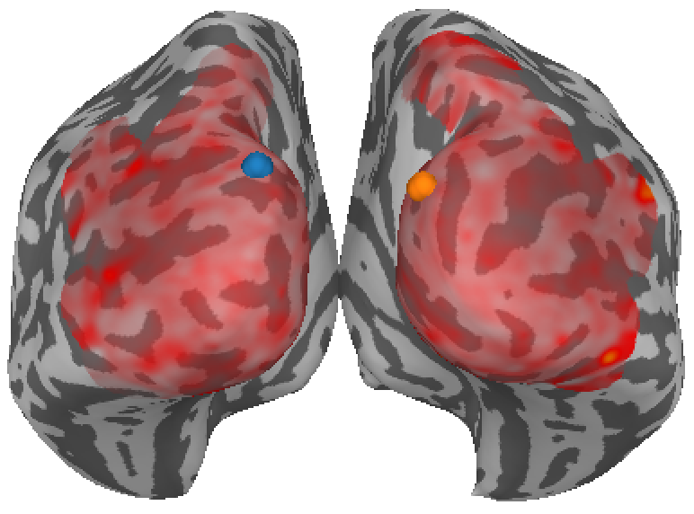
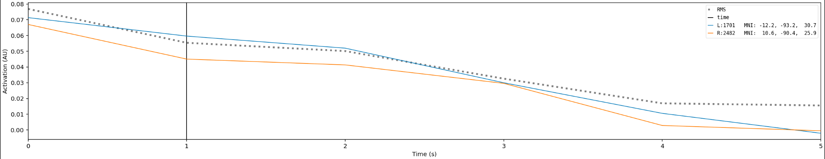
What are the outcomes of the pipeline replication?
Figure 3. Left: Grand average power map of the contrasting condition (normal face – scrambled face / baseline) for the alpha band (7-13 Hz) taken at 1 s. A caudal view is shown. Right: Corresponding activation plot for each hemisphere over time.
Introduction
Methods
Results
Conclusion
Greater bilateral activity in the visual areas when normal faces are presented than scrambled
Additional result; improvement #2
Notes:
In bold are the hyperparameters

Slide 9
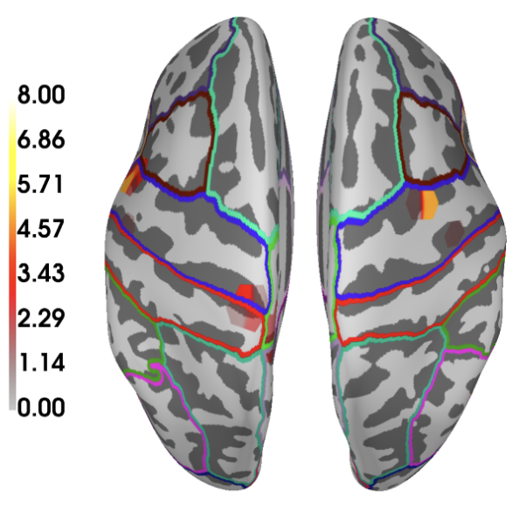
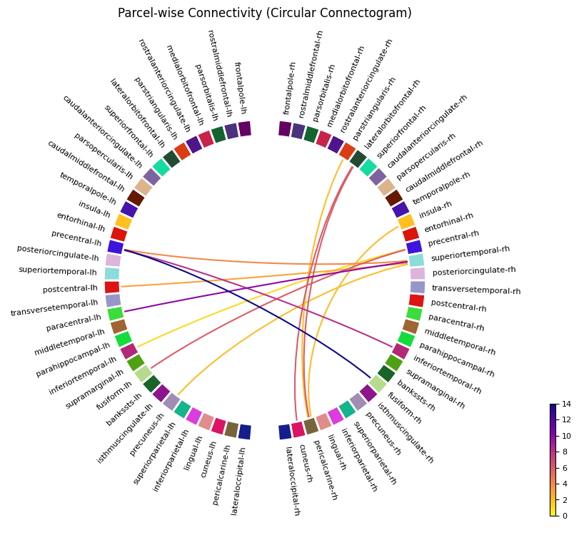
What are the outcomes of the pipeline replication?
Figure 4. Top: Degree map showing the no. of surviving connections. Right: Connectogram arranged by hemisphere showing the connections between each parcel. Low gamma, contrast.
Introduction
Methods
Results
Conclusion
Reflects the role of right fusiform gyri in face processing;
Improvement #3
Reflects right hemi- sphere advantage for face processing;
Improvement #4
Notes:
In bold are the hyperparameters

Slide 10
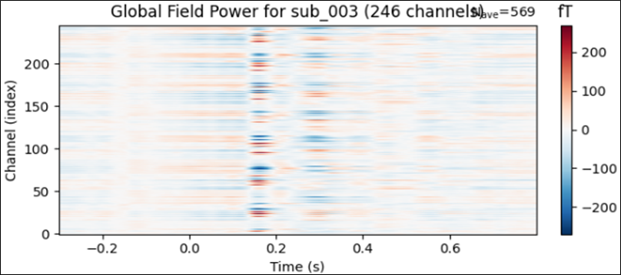
What are the outcomes of the pipeline implementation?
Figure 5. Global field power (GFP) showing the sensor-wise (n = 246 magnetometers) temporal dynamics of ERF across conditions (n = 18), for Subject 003. Regardless of value, darker colors reflect higher ERF magnitudes (~1e-15 Tesla, fT). Across sensors, the GFP peaks during two time windows: close to 0.2 s (M190) and around 0.3 s (M300)
Introduction
Methods
Results
Conclusion
Notes:
In bold are the hyperparameters

Slide 11
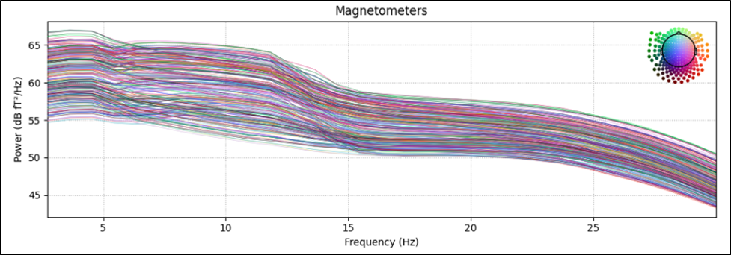
What are the outcomes of the pipeline implementation?
Figure 6. Power spectral density (PSD) across frequencies (2-30 Hz), time (-0.3-0.8 s), and sensors for Subject 003. The estimated power is measured in decibels (dB). Spectrum lines are colored based on sensor location (top right). The usual trend of decreasing spectral power with increasing frequency is apparent. At relatively lower bands (i.e., theta to alpha) and higher bands (i.e., beta), the PSD respectively exhibits gradual and sharp decreases.
Introduction
Methods
Results
Conclusion
Notes:
In bold are the hyperparameters

Slide 12
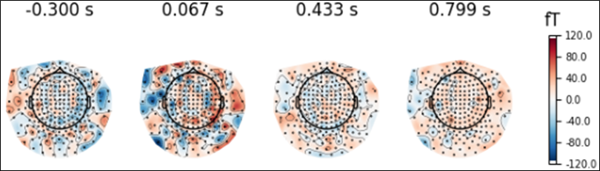
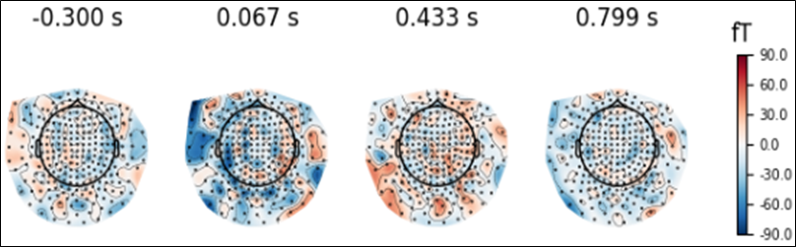
What are the outcomes of the pipeline implementation?
Figure 7. Topographic maps, based on local extrapolation, across frequency (1-30 Hz) for the (top) 1st presentation and (bottom) 2nd presentation of food images, for Subject 003. Relative to baseline (leftmost maps), there is higher activation across the post-stimulus window (succeeding maps). Among these, peak activation occurs shortly after stimulus onset (0.067 s), present in the left anterior, right temporal and posterior sensors.
Introduction
Methods
Results
Conclusion
Notes:
In bold are the hyperparameters

Slide 13
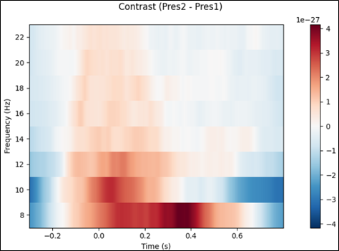
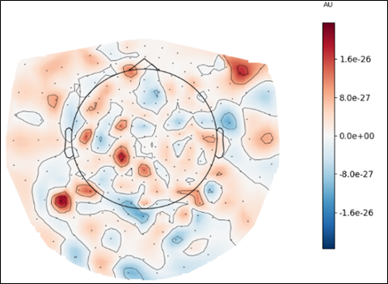
What are the outcomes of the pipeline implementation?
Figure 8. Time-frequency representation (TFR) of the difference in response between 1st and 2nd presentation, regardless of image category and lag duration. The topographic map roughly represents the boxed regions in the TFR.
Introduction
Methods
Results
Conclusion
Notes:
In bold are the hyperparameters

Slide 14
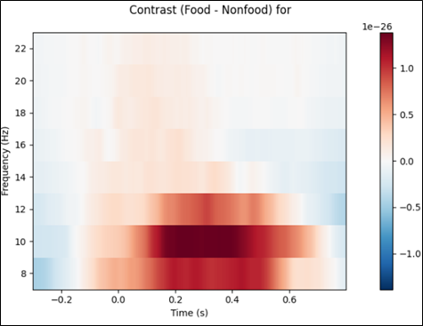
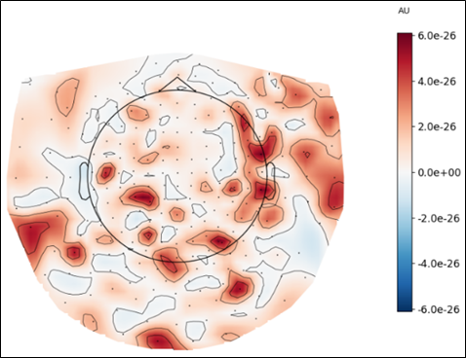
What are the outcomes of the pipeline implementation?
Figure 9. Time-frequency representation (TFR) of the difference in response between food and non-food (positive and neutral images), regardless of presentation and lag duration. The topographic map roughly represents the boxed regions in the TFR.
Introduction
Methods
Results
Conclusion
Notes:
In bold are the hyperparameters

Slide 15
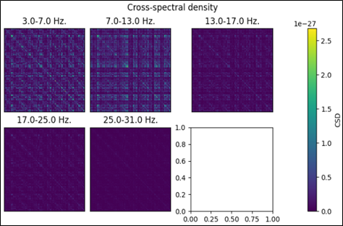
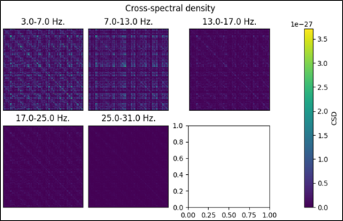
What are the outcomes of the pipeline implementation?
Figure 10. Mean CSD matrices averaged over the defined frequency bands, analogous to those of van Vliet et al. (2018), for the 1st presentation of food images for Subject 003. The (left) baseline matrices serve as reference for (right) post-stimulus matrices.
For a more comprehensive view, CSD matrices (e-f) per frequency are presented as well in the next slide.
Introduction
Methods
Results
Conclusion
Notes:
In bold are the hyperparameters

Slide 16
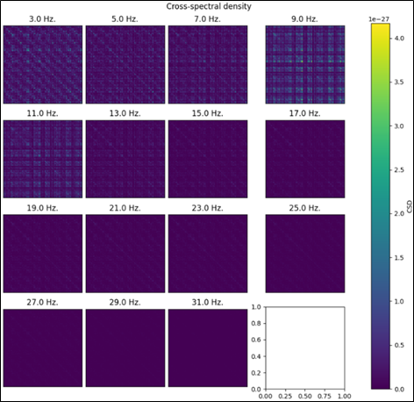
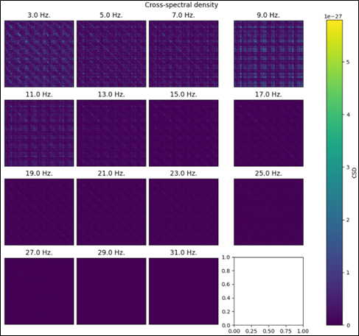
What are the outcomes of the pipeline implementation?
Introduction
Methods
Results
Conclusion
Notes:
In bold are the hyperparameters

Slide 17
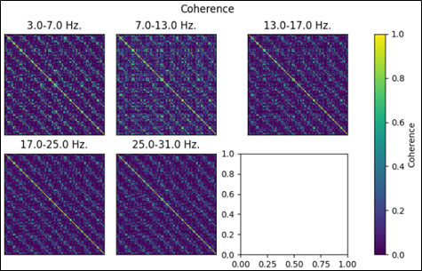
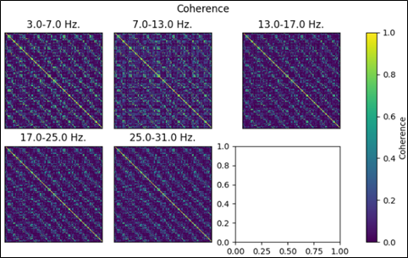
What are the outcomes of the pipeline implementation?
Figure 11. Coherence matrices averaged over the defined frequency bands, for the 1st presentation of food images for Subject 003. The (left) baseline matrices serve as reference for (right) post-stimulus matrices.
Introduction
Methods
Results
Conclusion
Notes:
In bold are the hyperparameters

Slide 18
What have we achieved and learned in this project?
Introduction
Methods
Results
Conclusion
Reproduced successfully the results of van Vliet et al. (2018), with several key improvements
Provided intuition and foundation for temporal, spectral, and spatial analyses of the food dataset
Working cross-platform (FieldTrip in Matlab to MNE in Python) is not ideal
MRI estimation for MEG source analysis is not recommended :(
Notes:
In bold are the hyperparameters

